Slide 1

Special Tees Business Intelligence Initiative
Bhavin Vinod Jain, Brendan Jacques, Matthew Finn, Robert Johnson, Utsav Nandlal Jain
Notes:
I can read this slide- Robert

Slide 2
Introduction
Notes:
I can read this slide, drawing from my executive summary- Robert

Slide 3

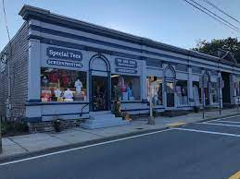
Introduction
Here’s what we will discuss:
The business and their current BI situation
Two Case Studies
Two dashboards, and a prototype predictive model
Documents about BI implementation
Give our final thoughts and recommendations for Special Tees

Slide 4
Case Studies
Notes:
I can read this slide, drawing from my executive summary- Robert

Slide 5
GAP Inc. Case Study
Founded in 1969 by Donald and Doris Fisher.
3,666 physical stores around the world. It generated global sales of $16.58 billion in 2018.
Google Analytics, Googles trends used to collect data and help track and report a company’s website and app real-time data such as number of users, total number of pages viewed, total number of sessions (the period of time a user is actively engaged with the website or app), customer demographic data, the keywords and sites that referred them.
Company should keep track of who buys what based on age, gender, location, etc. to avoid any inventory backlogs and deep discounting problems which are being faced by them.

Slide 6
Magazine Luiza Case Study
One of Brazil’s largest retailers, both in-person and online.
Net revenue in 2020 of 43.52 billion Brazilian reals (about $7.8 billion)
Early pioneer in Brazilian online retail (as early as 1992)
Project Bob - An AI tool that recommends products to customers based on browsing and purchase history.
Initially meant to personalize recommendations to customers.
Expanded over time to personalizing entire storefronts per-customer.
Organizational changes to accommodate BI solutions must be implemented.
Upper management must be involved in the process
Data availability between all employees is essential.
Clear lines of communication with employees is critical.
Radical shifts in the business model of a company should be expected.

Slide 7
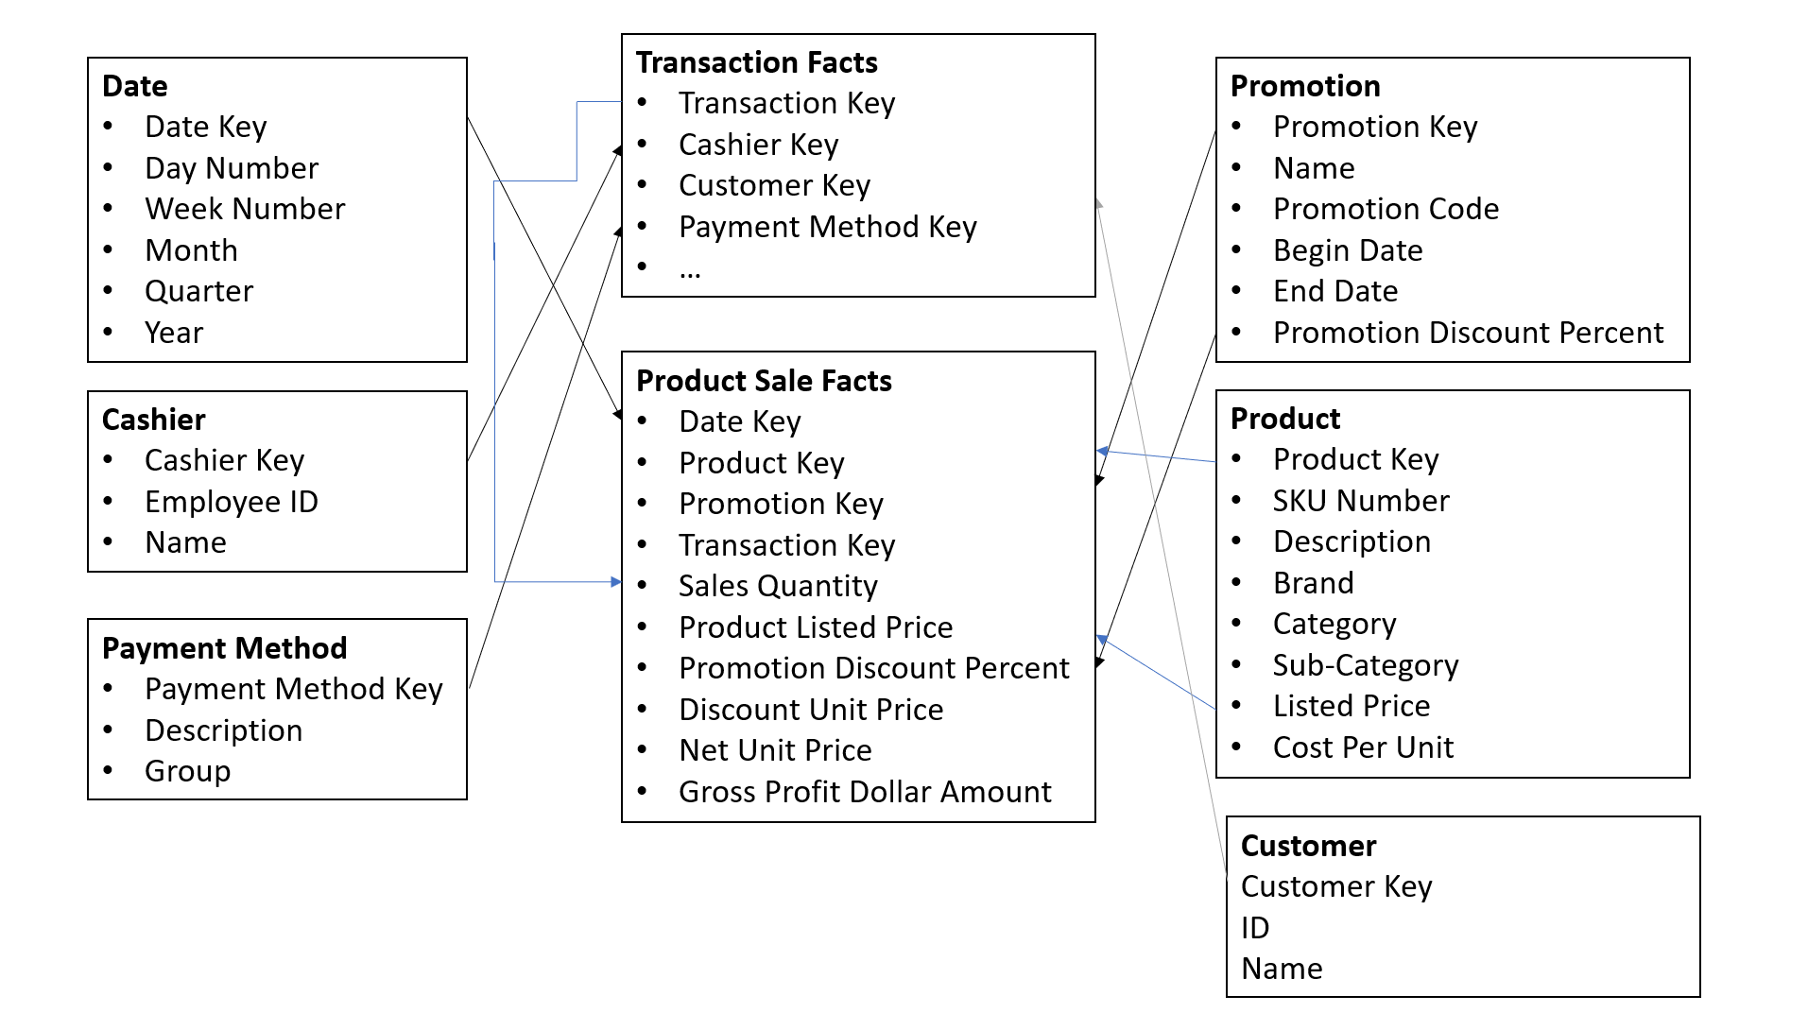
Our Proposed BI Solution
Data Warehouse containing:
Transaction Sale Data
Product Sale Data
Customer Data
Customer Complaint Data
Implement Protocols for Greater Data Collection
Develop Data Analytics Tools
Wide number of use cases
No programming Knowledge Required
Three Prototypes
Customer Complaints Dashboard
Sales Analytics Dashboard
Customer Retention Prediction Algorithm

Slide 8
Complaints Dashboard

Slide 9

Complaints dashboard

Slide 10
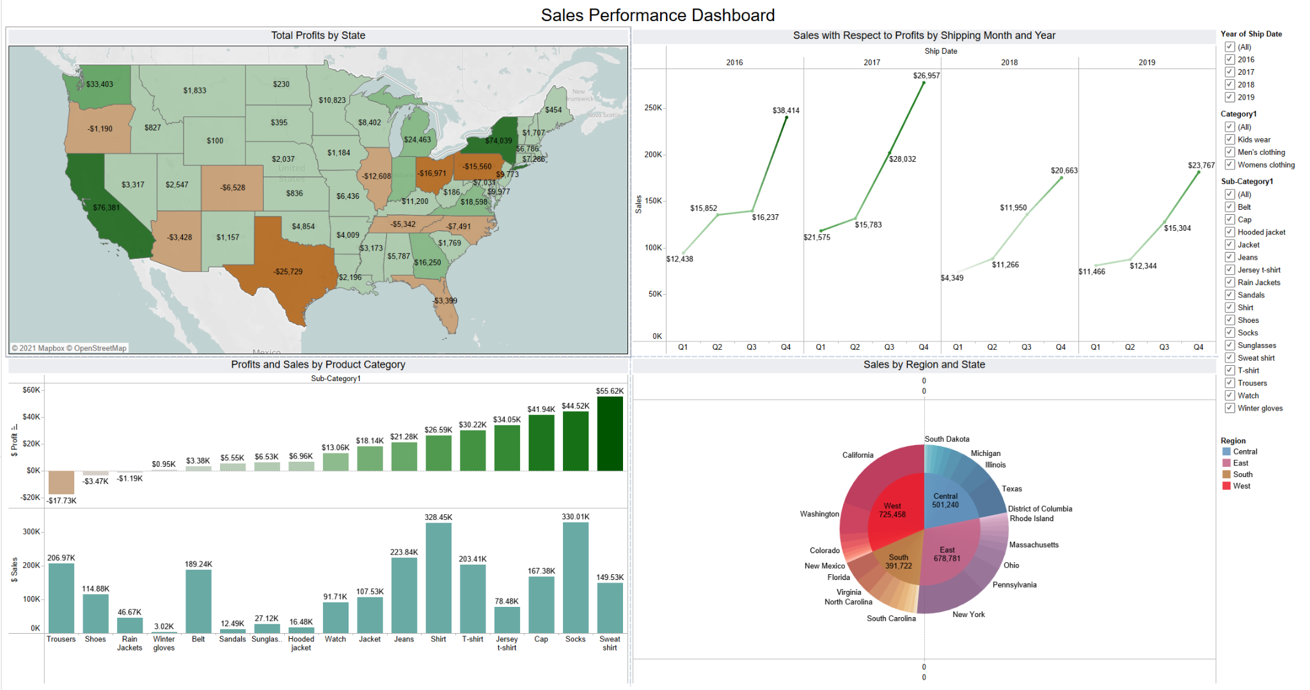
Sales Analytics Dashboard

Slide 13
Prototype 3

Slide 14
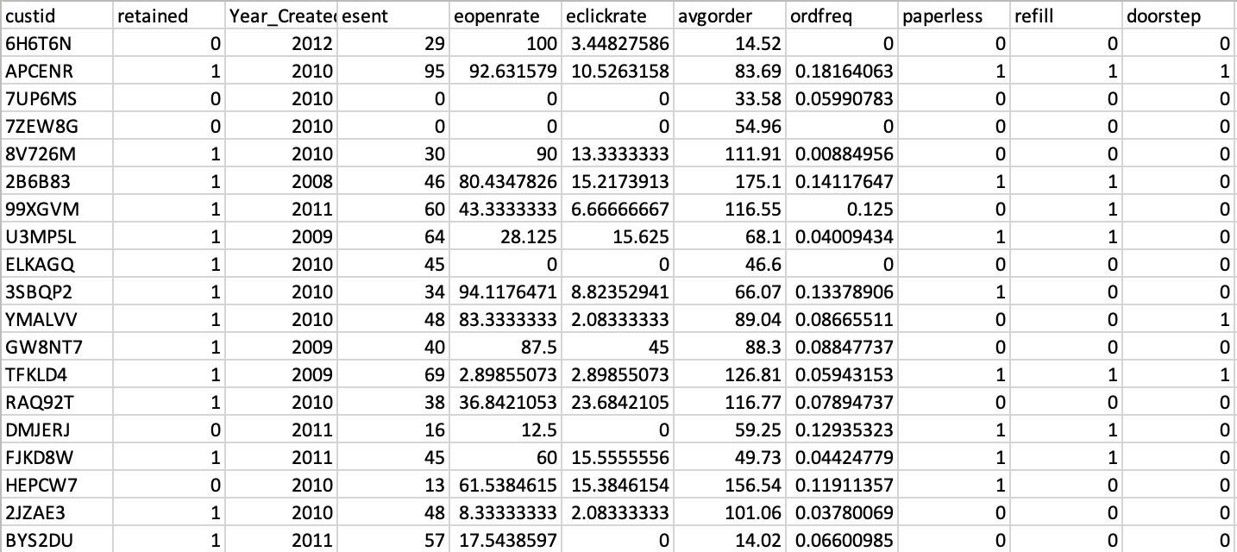

Best Subsets Regression
Goal
Test every possible combination of the predictor variables in a dataset. Then, according to the particular statistical criterion of the user’s choice, the algorithm selects the best model.
1
Application
Data that affects whether a customer is retained or not.
2
Software
R. Packages include tidyverse, caret, and leaps
3

Slide 15
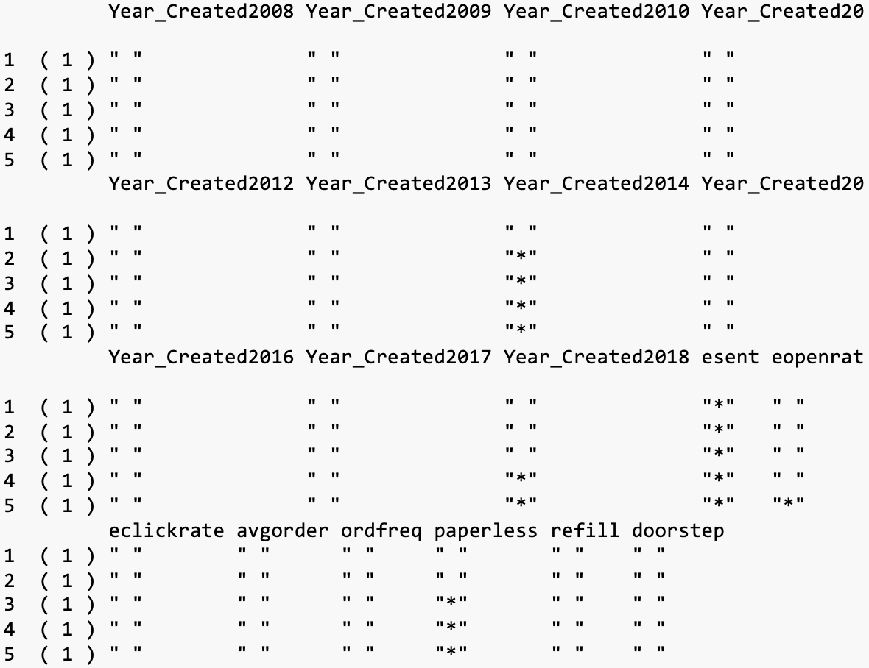
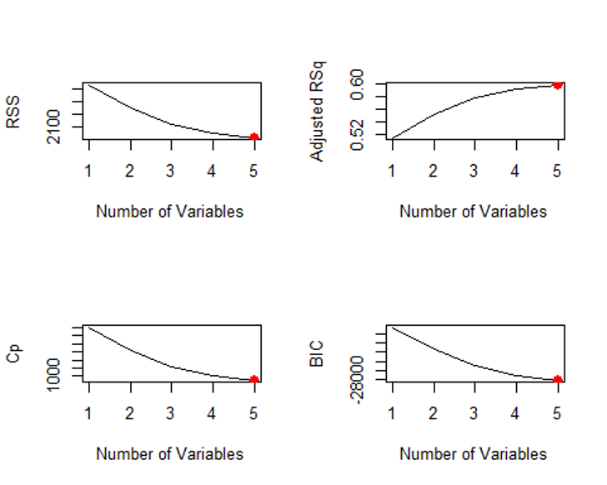
Process
Choose which variables you’d like to use to predict customer retention:
Maybe average order, order frequency, emails opened
Run the regression technique
Analyze which model is best by running metrics

Slide 16
Client Value
Simple
Doesn’t require change
Many factors that could affect retention
Plenty of other uses for this technique
The algorithm is quite simple to perform and only takes a few lines of code. It is easily customizable to any dataset that has a target variable.
Special Tees already has a customer database that is likely filled with plenty of features that can affect a certain target they’d like to analyze.
There are so many aspects that go into keeping a customer and they are often too difficult to analyze without an algorithm.
This prototype could help with other areas of analysis, like whether a sale is in person or online, the nature of large vs small orders, or features that affect particular inventory sales.

Slide 17
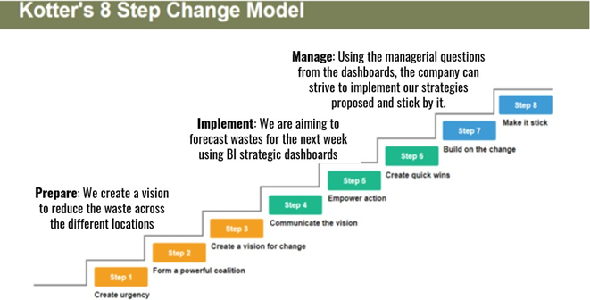
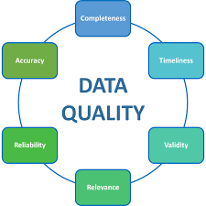
Implementation

Slide 18
Summary and Recommendations
Notes:
I typed up a script for this slide - Robert

Slide 19
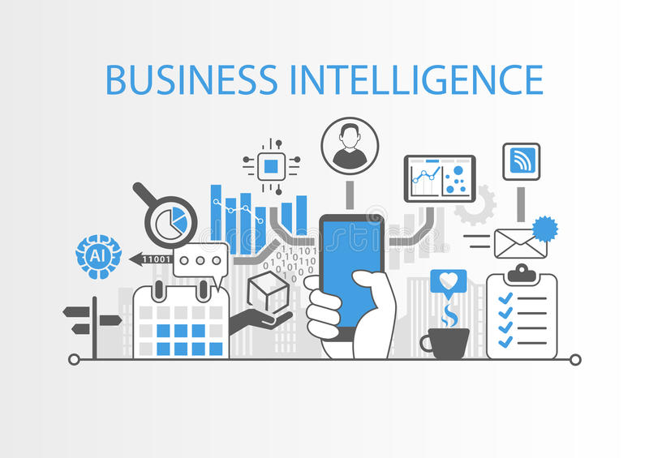
Summary
What we’ve talked about so far:
Status of BI at Special Tees
Case Studies
Dashboards and Models
Their insights into operations
Specifically tailored to the business

Slide 20

Recommendations
Where to go from here:
Determine end goal of BI projects and initiatives
Get input and plan
Collect data and decide on metrics and analyses
Follow Kotter’s 8 Step model:
Communication, Evaluation, etc.
These projects are important, so start planning!

Slide 21
Thank you for listening!

